Slide 1
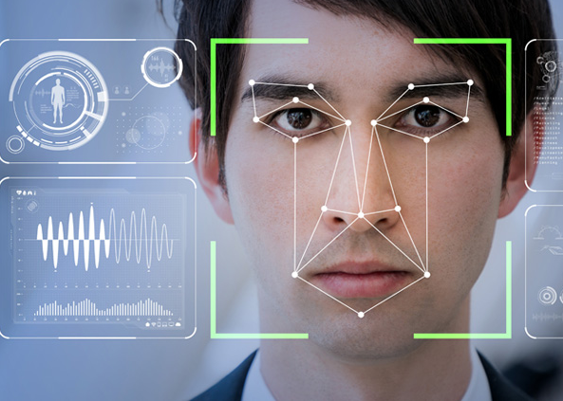
SECURE FACE

Slide 2
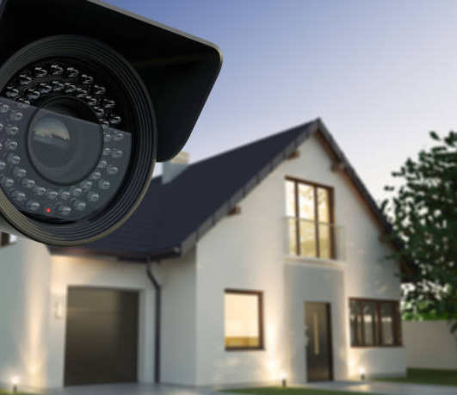
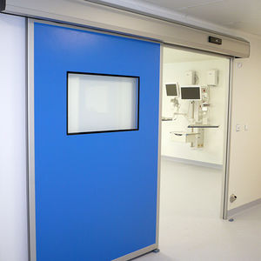
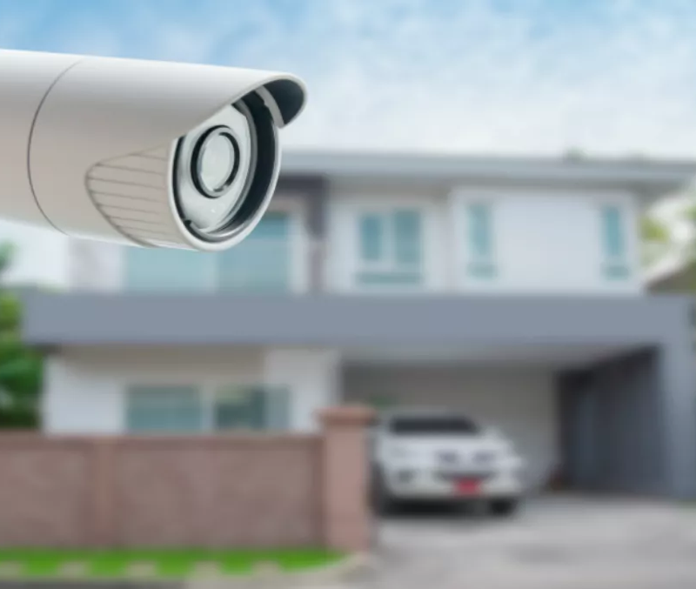
Problem Statement:
Secureface is a mechanism to record and identify a person by his face.
Can be used in :
Alarm systems
Door open

Slide 3
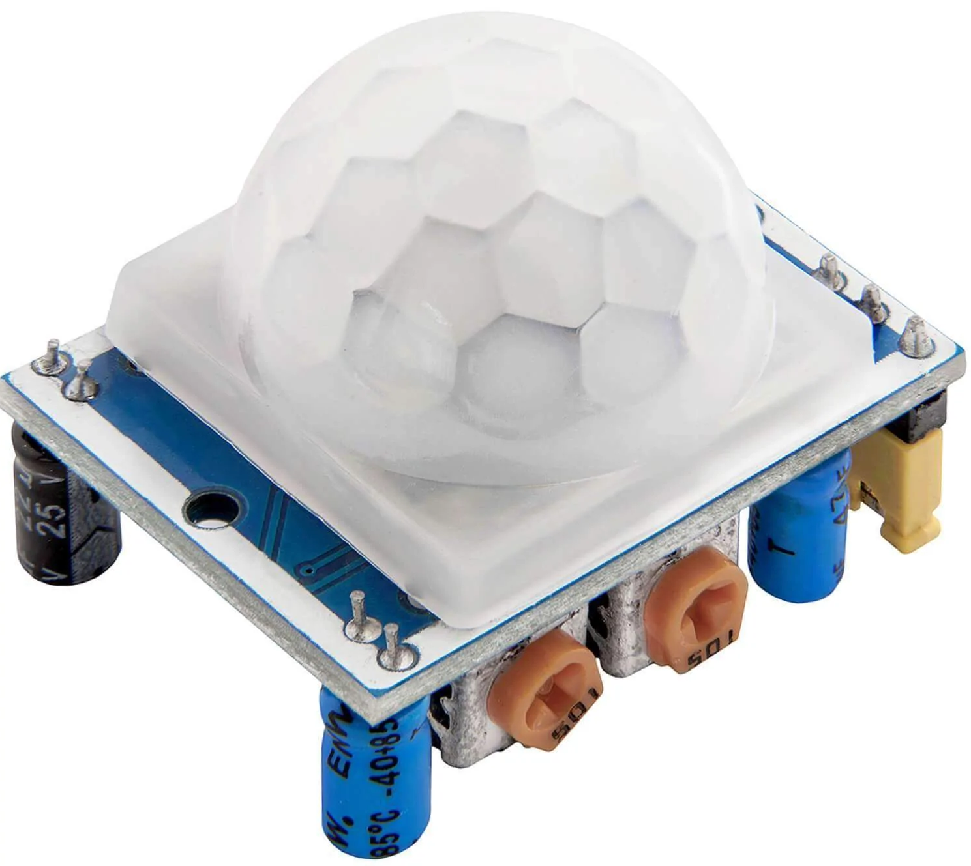
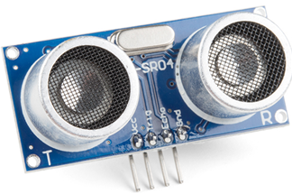
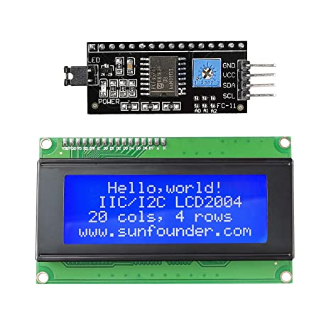
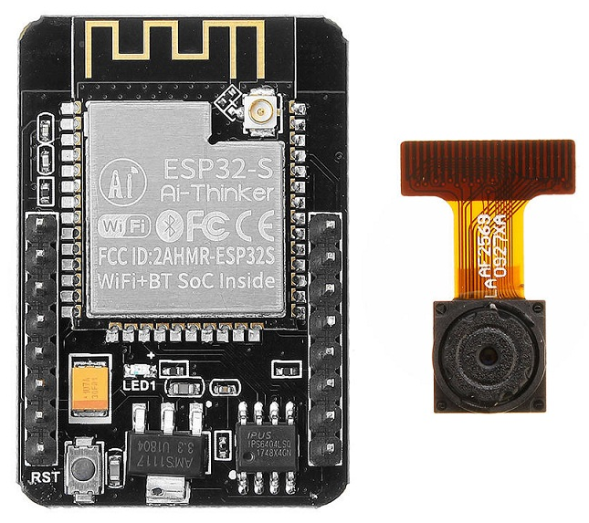
Working Scheme
START
User runs the program
PIR Sensor
Capts a movement and starts the ultrasonic sensor
LCD display
Prints the name of the person
Ultrasonic sensor
Waits until the person is next to it and activate the Esp camera
ESP32cam Ai-thinker board
Takes 10 photos in 1 second and sends them via Wi-fi to the server
The server
Starts the recognition function and sends back the result

Slide 4
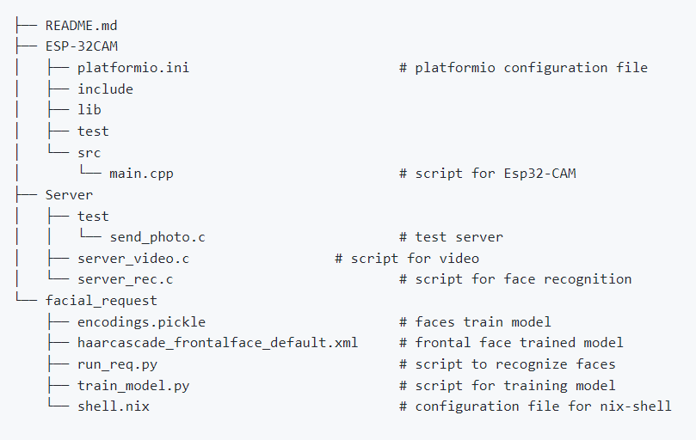
Software Architecture
○ Describe the core software blocks of your system.
■ Explain the working flow of the software by giving details on the hardware/software interaction:
● e.g., which interrupts you used, how you serviced the interrupts? Explain how you sense data, how do you interpret and process the data.
■ Indicate what kind of data structures and algorithms you used within your code. ○ You can also present some core C codes for your implementation but just the most important and representative lines (a couple of lines)

Slide 5
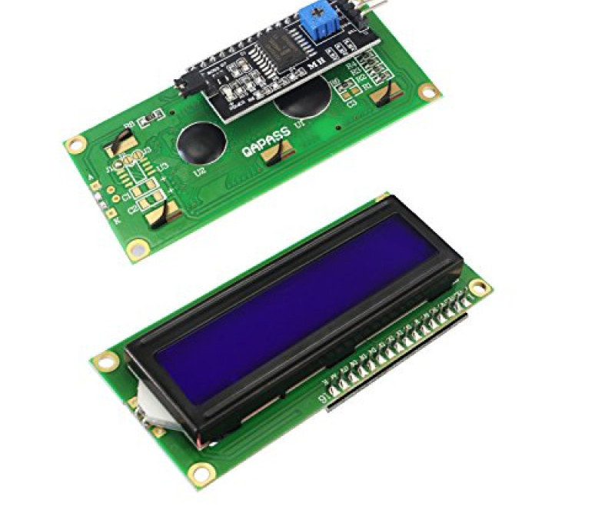
Testing
○ Describe how did you test the software.
Problems:
LCD pins were too many for the ESP32cam → Got a new LCD and an Arduino nano
Raspberry too weak → More time for computing and testing

Slide 6

Conclusions and Future Work
Implement a crypted communication
Create a database on which save the camera’s recordings
Add a door opening actuator

